Slide 1
COVID 19
RESPONSE
Tipiziwin Tolman

Slide 2
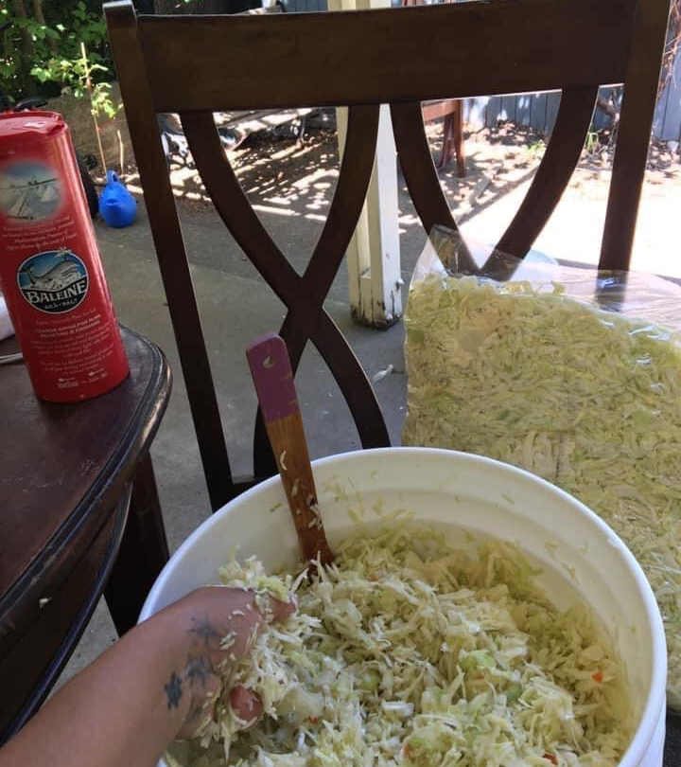
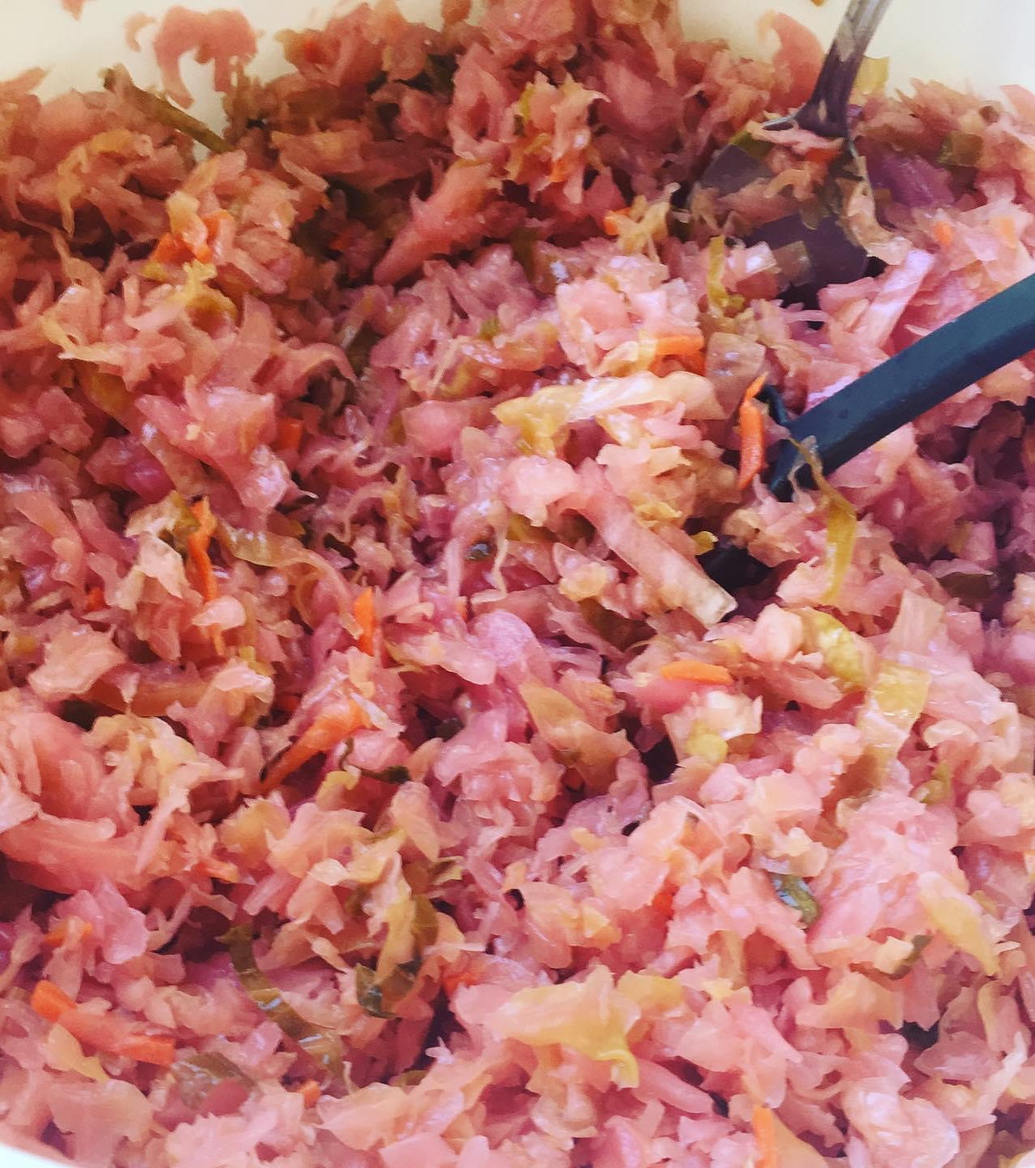
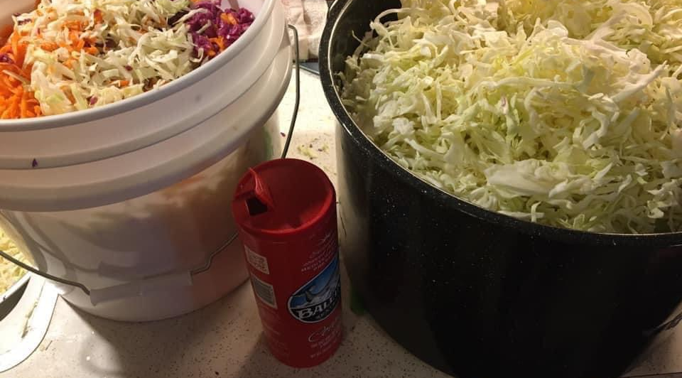
Cabbage + Salt =
SAUERKRAUT

Slide 3
Weigh Cabbage by grams & Multiply by .o2

Slide 4
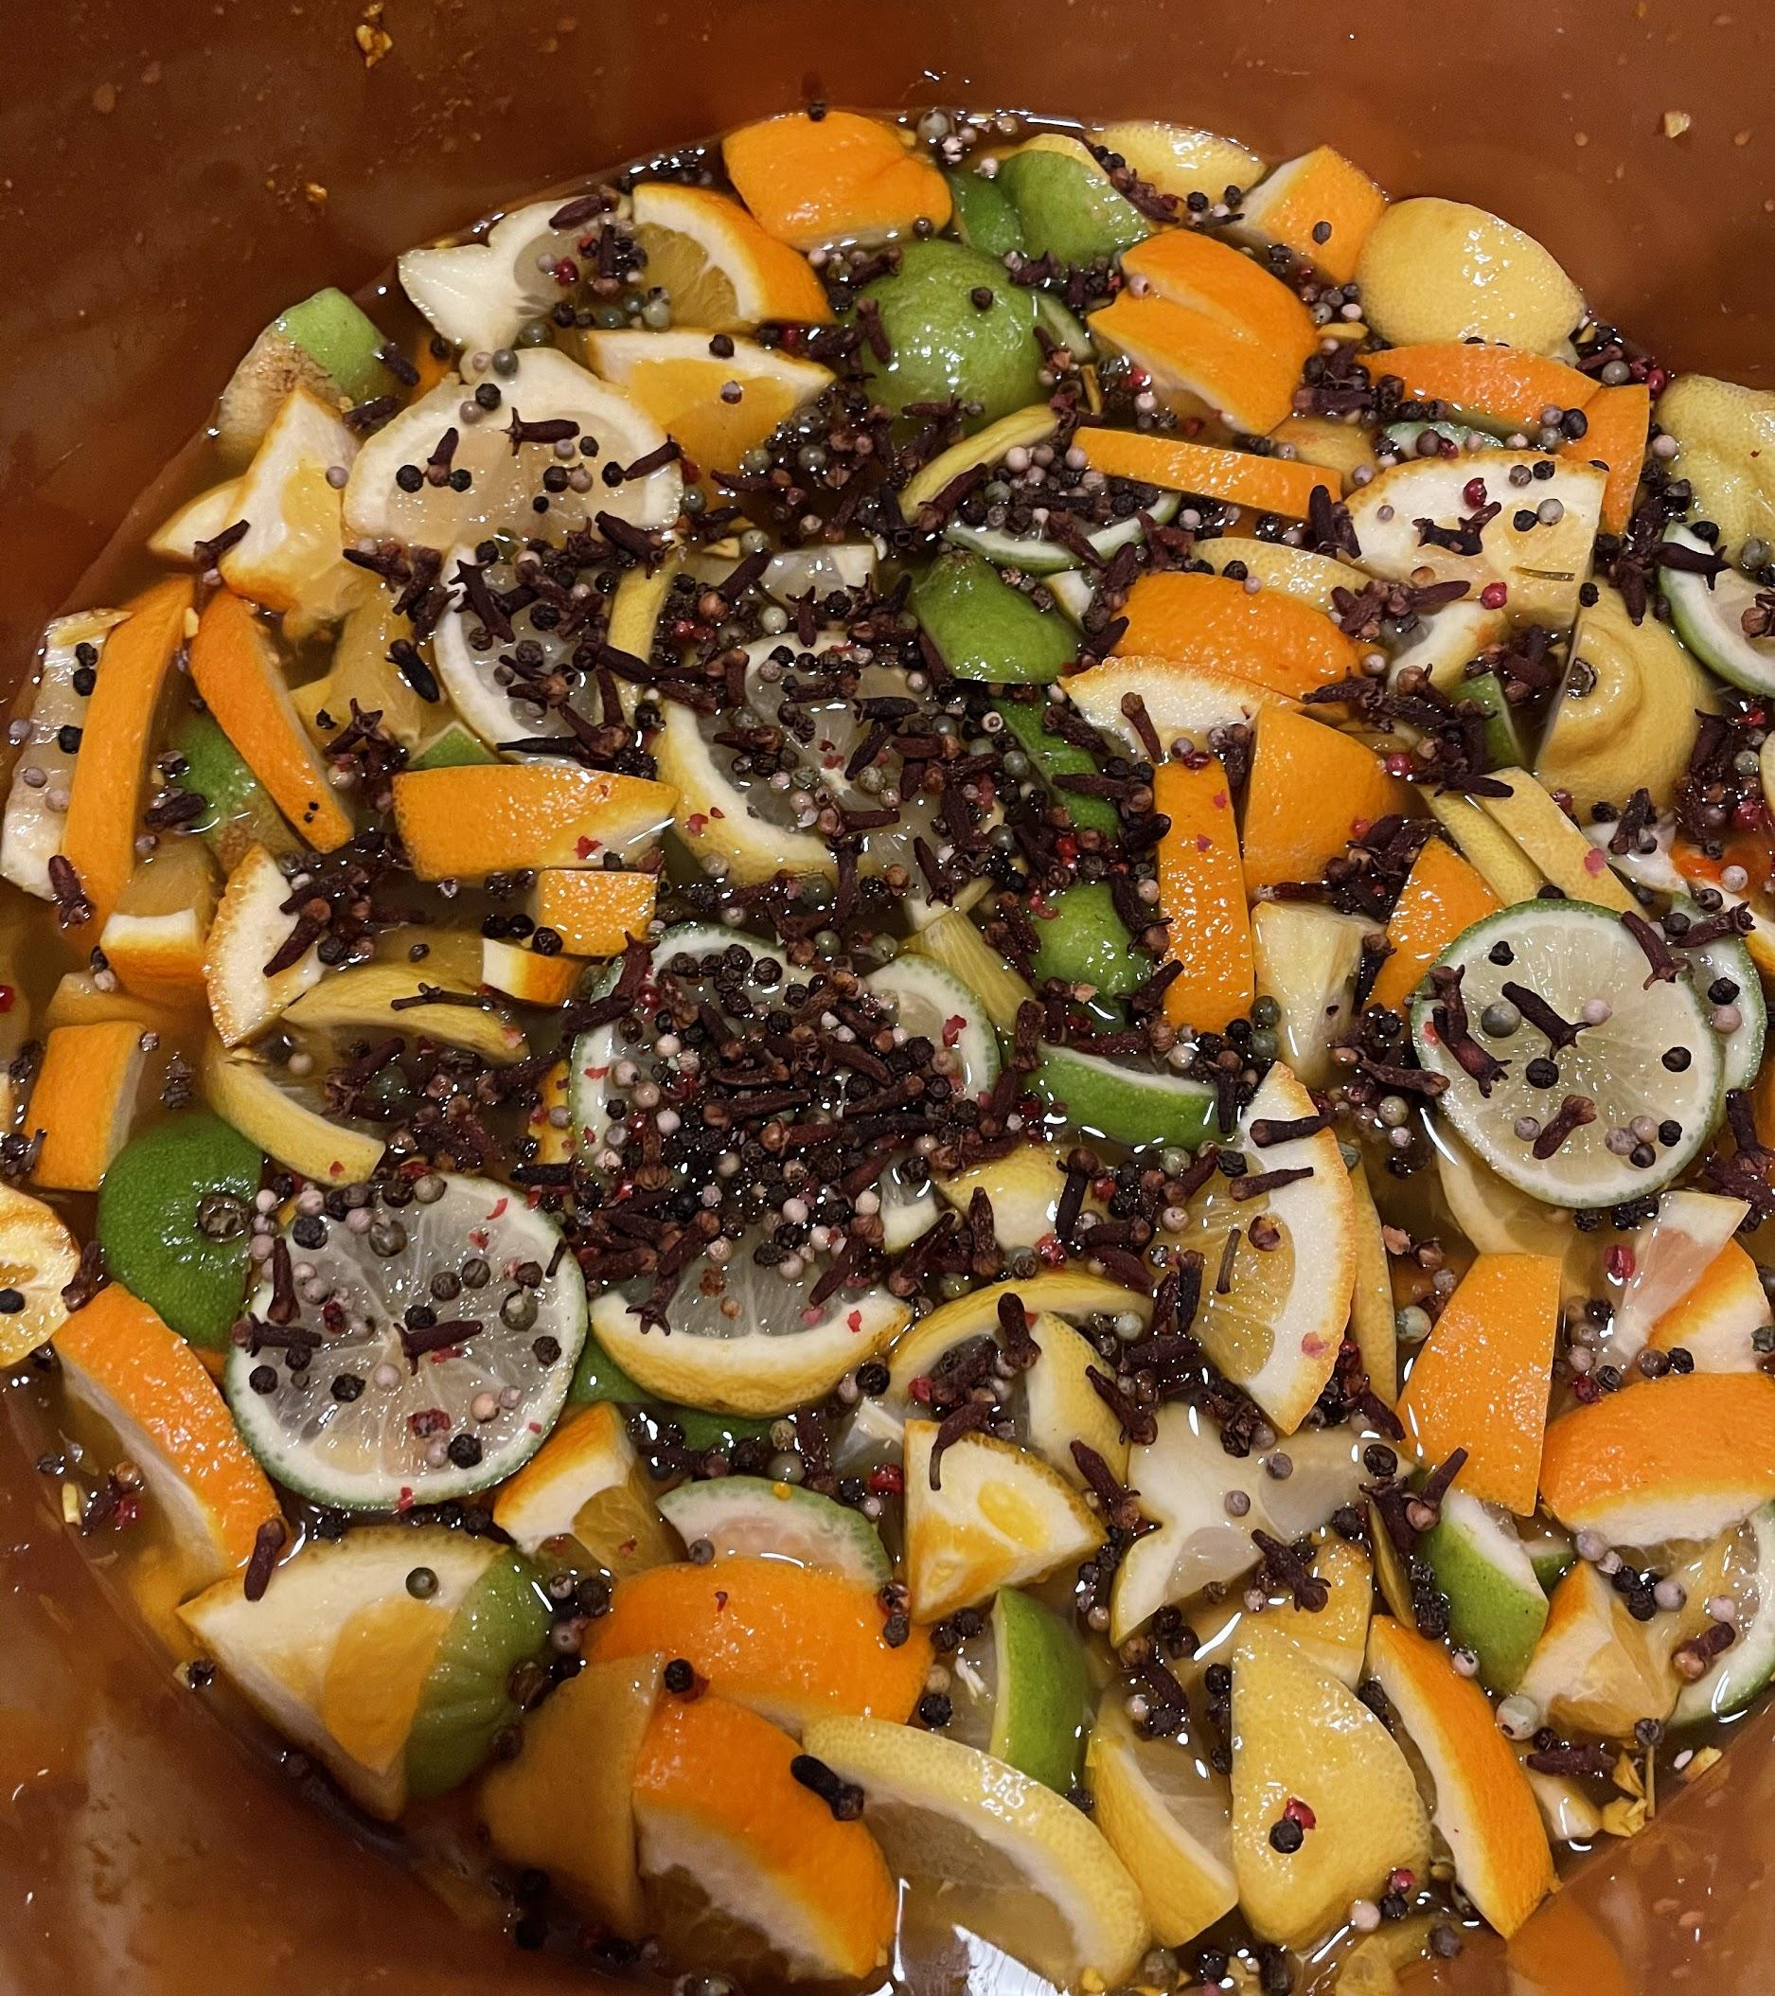
Fire Cider
Food As Medicine
Respiratory Support

Slide 5
Fire Cider

Slide 6
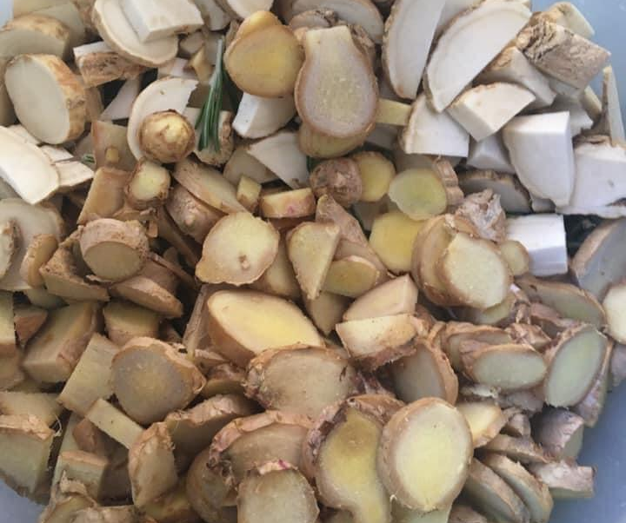
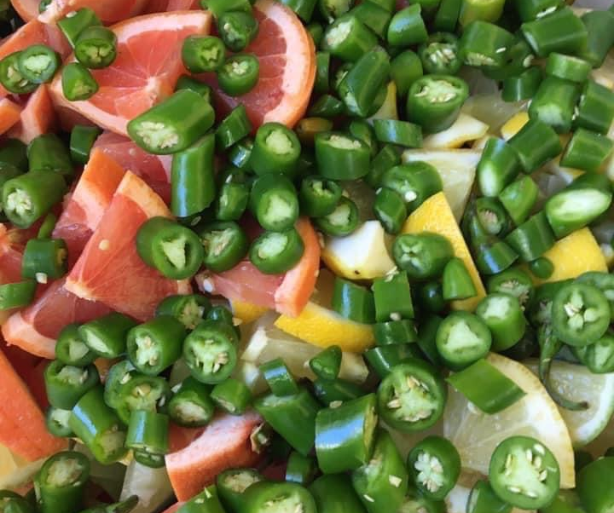
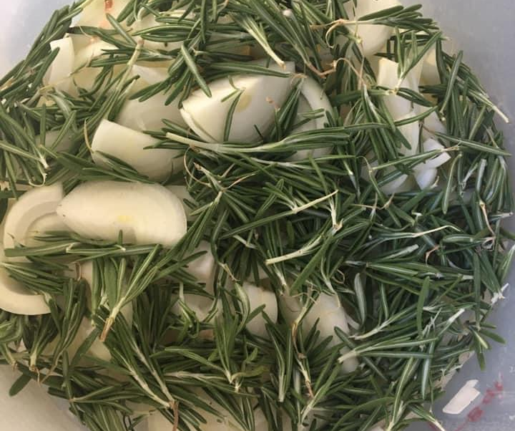

Slide 7
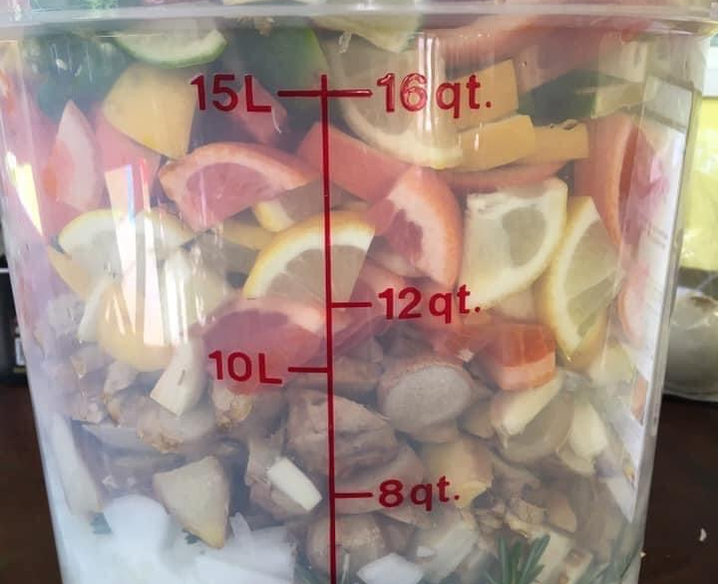
Fire Cider

Slide 8
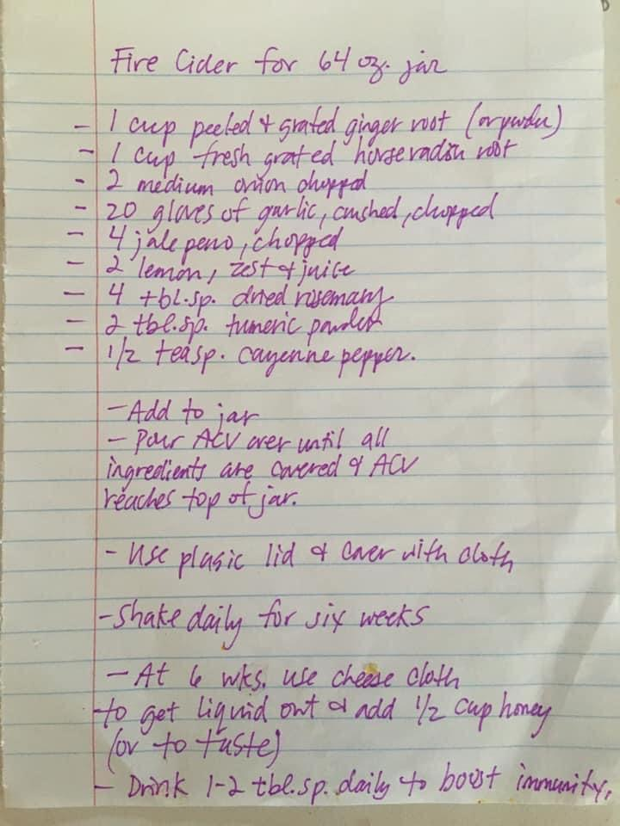
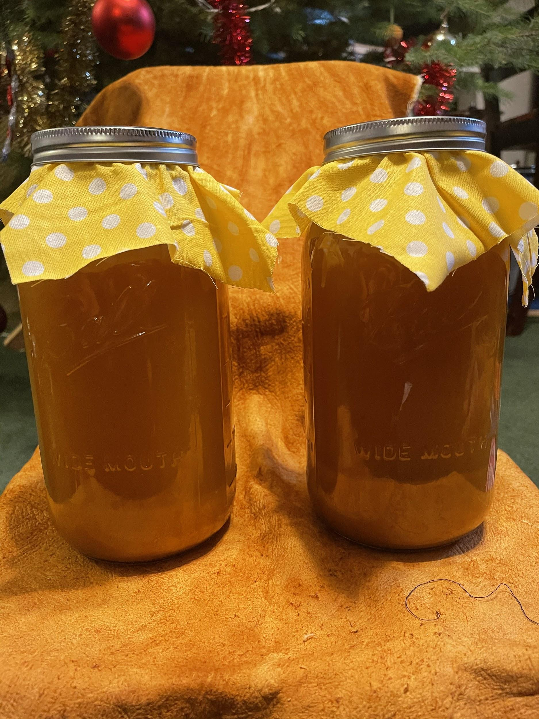

Slide 9
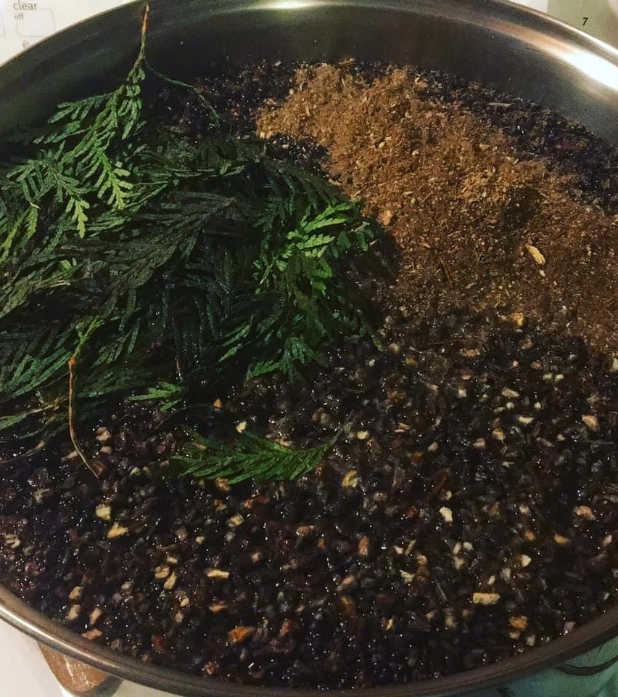
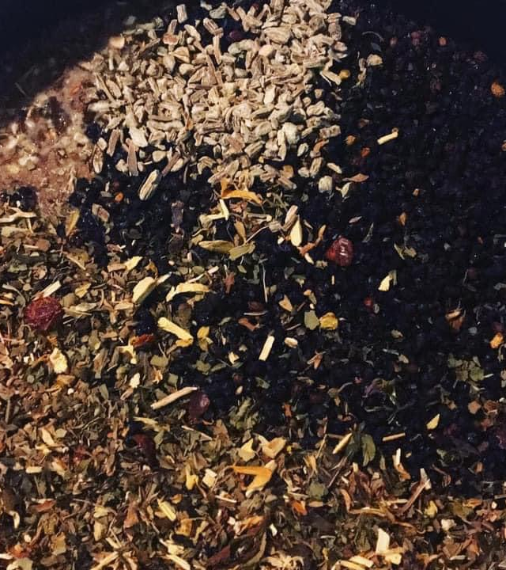
Elderberry Syrup

Slide 10
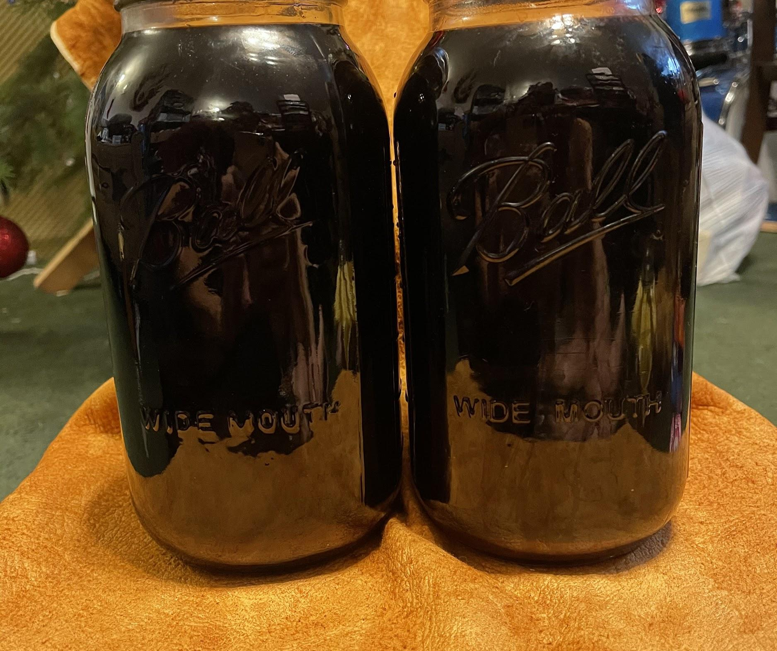
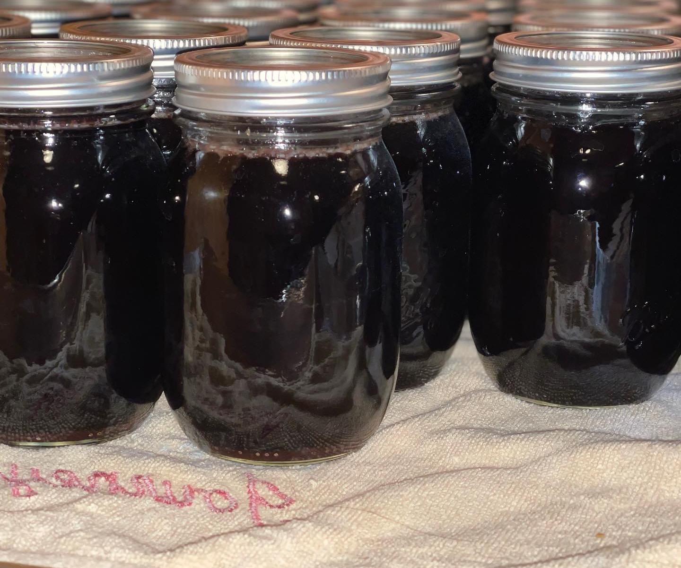
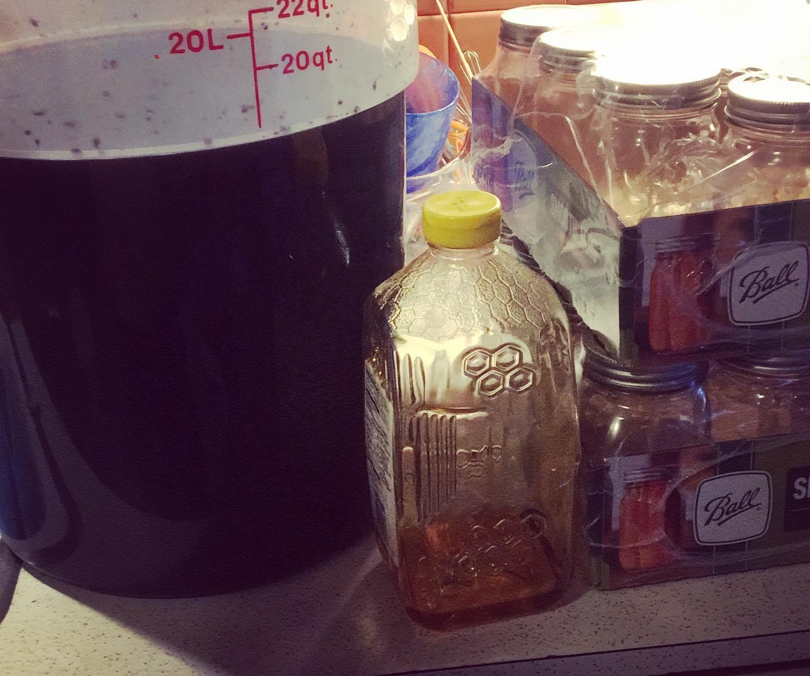
Elderberry +
Boiling Water =
Elderberry Tonic
Syrup
Elixir

Slide 11
One pound of dried elderberry plus six quarts of water

Slide 12
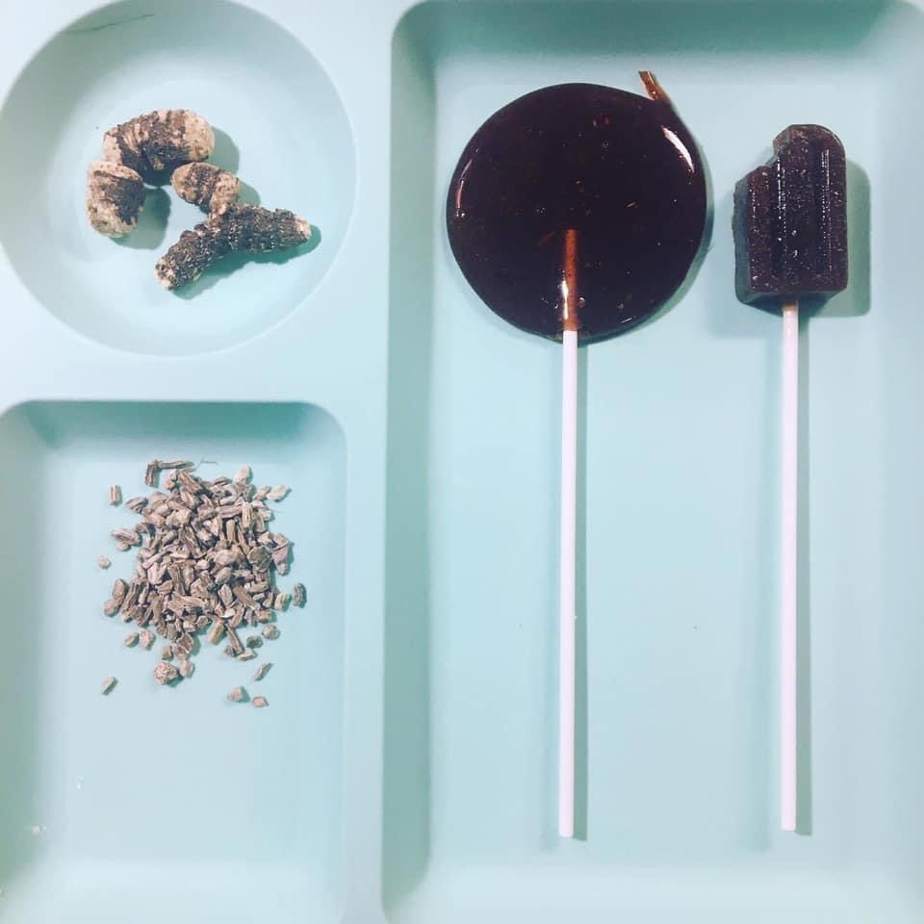
Bear Root
Candy Cough Drops

Slide 13
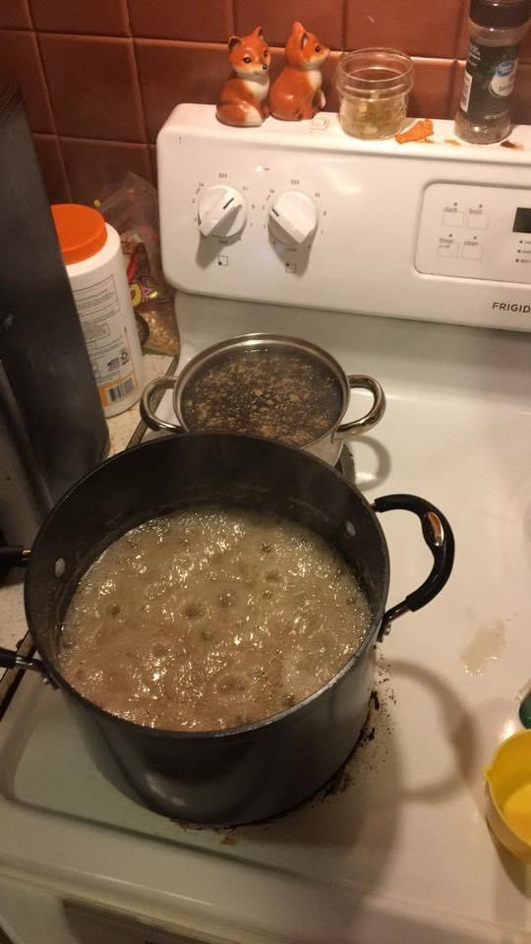
Making bear root candy cough drops. Not for sale, for COVID and COVID recovering families.
But! Everyone can make some!
Here is my recipe I use: I found it with the Google (lol)
2 cups of water (bear root or bitter root tea) Light boil.
3 cups of corn syrup
7.5 cups of sugar
Add all together bring to a boil enough to dissolve the sugar.
Bring to a roiling boil DO NOT stir, you can use a silicon spatula to make it go down on the sides.
Let it boil like this until it reaches 310 degrees. (Takes awhile, be patient) DO NOT STIR
Take it off the stove, add two TBS of extract (I use peppermint) mix
Pour onto sheets (like peanut brittle then break up) or molds, dust with powdered sugar to keep from being too sticky.
Bear Root Candy Cough Drops

Slide 14
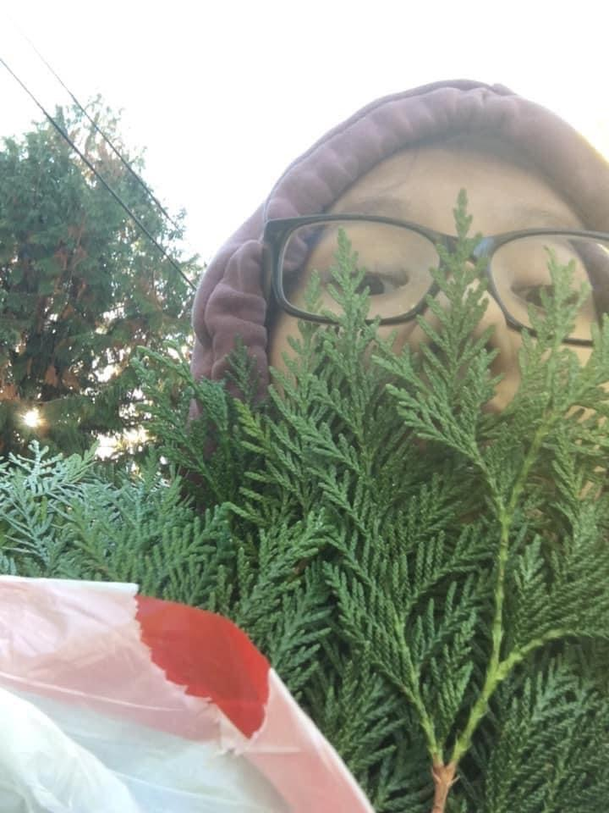
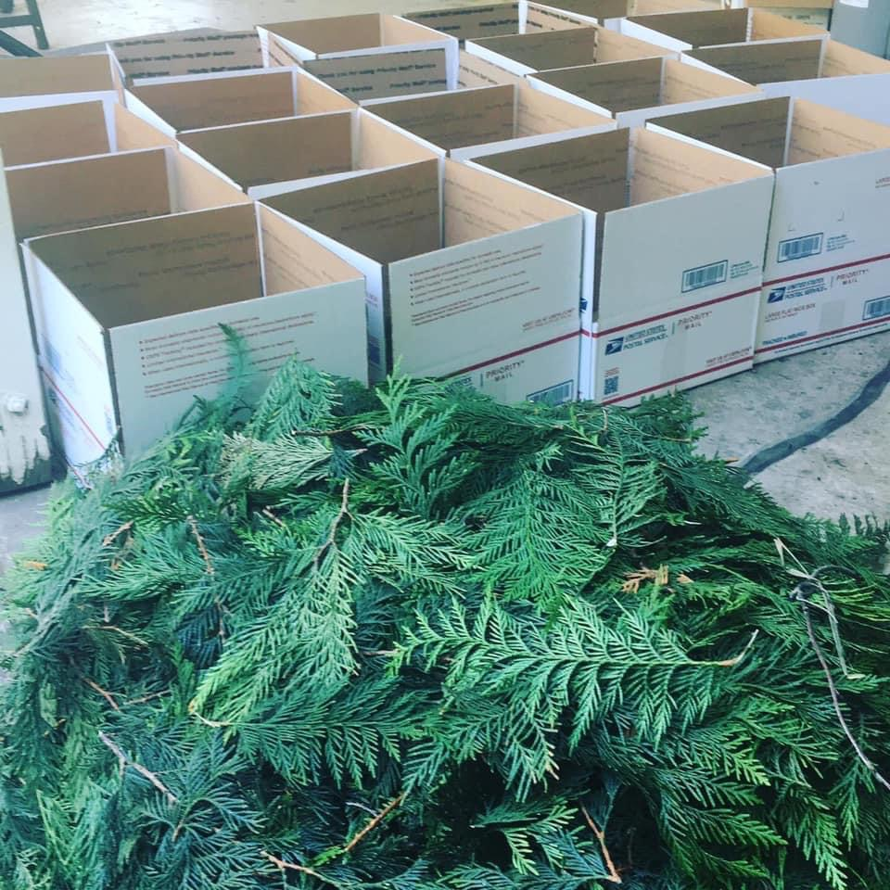
Cedar as gift

Slide 15
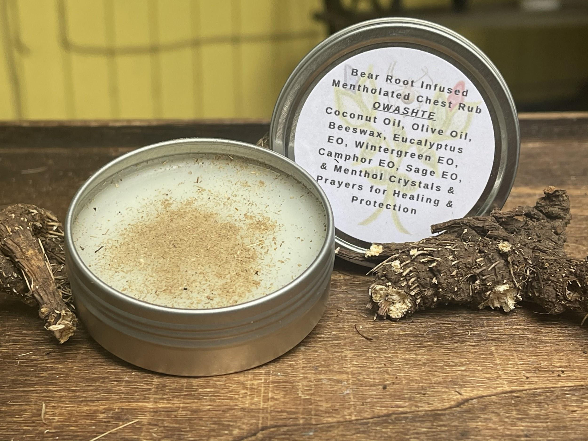
Mentholated Bear Root/Bitter Root Chest Rub

Slide 16
Mentholted Chest Rub Recipe
2 cps organic coconut oil
2 cps organic olive oil
1 cp beeswax
4-8 tbsps essential oils
8 tbsps menthol crystals
Melt oil and beeswax, remove from heat, add essential oils and menthol crystals, mix well, pour into containers.

